Slide 1
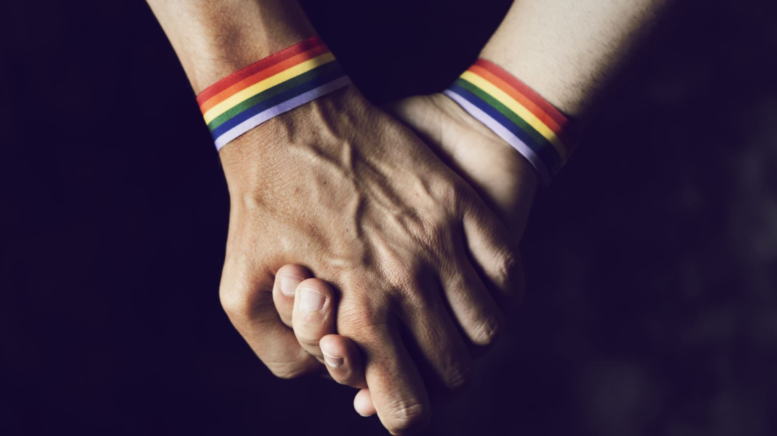
LGBTQIA+

Slide 2
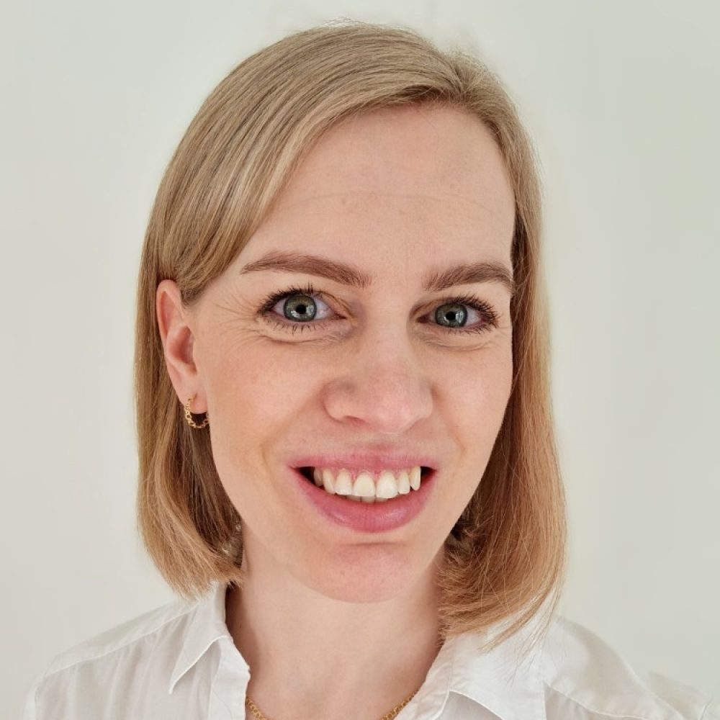


Our Stories

Slide 3
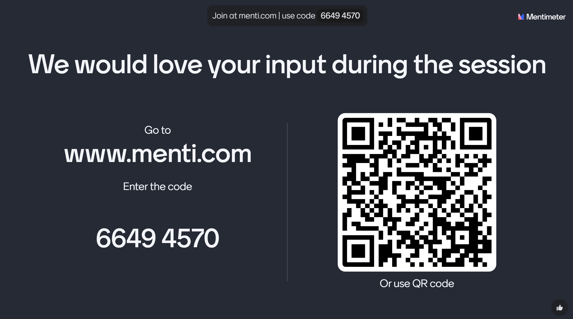

Slide 4

What does LGBTQIA+ mean?
Notes:
Go through what each letter in LGBTQ+ stands for. And how these minorities would benefit from an ally.
This whole concept came to be as a way to be more inclusive in recognizing diverse sexual orientations, gender identities and other expressions within the community.
Each letter represents a different aspect of identity, acknowledging the complexity and diversity of human experiences related to gender and sexuality.
LGBTQIA+: Abbreviation for Lesbian, Gay, Bisexual, Transgender, Queer, Intersex, and Asexual. The additional “+” stands for all of the other.
In more specific terms:
Lesbian: A woman who is emotionally, romantically, or sexually attracted to other women
Gay: A person who is emotionally, romantically, or sexually attracted to others of the same gender.
Bisexual: A person who is emotionally, romantically, or sexually attracted to more than one gender.
Transgender: A person whose gender identity differs from the sex they were assigned at birth.
Queer/Questioning: "Queer" can be an umbrella term for sexual and gender minorities who are not heterosexual or cisgender. "Questioning" refers to individuals who are exploring their sexual orientation or gender identity.
Intersex: A person born with variations in sex characteristics that do not fit typical binary notions of male or female bodies. In other words, it's a term used to describe people who are born with physical traits that don't fit typical definitions of male or female bodies. Being intersex is a natural variation of human biology.
Asexual/Aromantic/Agender: "Asexual" refers to individuals who experience little or no sexual attraction. "Aromantic" refers to individuals who experience little or no romantic attraction. "Agender" refers to individuals who do not identify with any gender.
Hope that makes the concept a bit more clear.

Slide 5
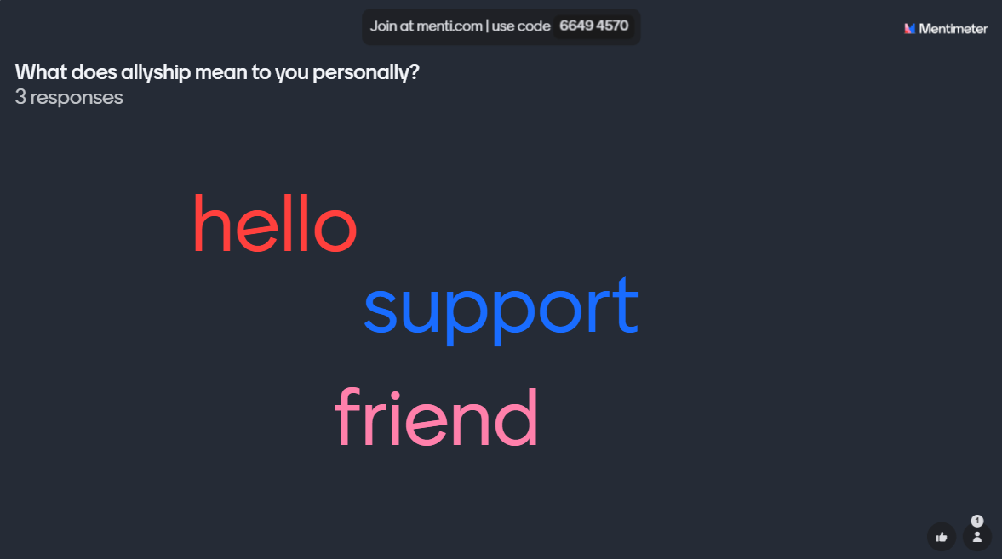
What does allyship mean to you personally?

Slide 6
Ally in the workplace
Notes:
Being an ally is not about making yourself look good or feel better. It is more about opening up the possibility to realize that you still have work to do.
You can be an ally even if you don’t identify as part of the community. Perhaps those are the best allies. Letting someone else, speak for us, can sometimes be the spokesperson people listen to. They are seen as more objective.
Minorities are just that- minorities. We are stronger in numbers even if those numbers are not only people from inside the community.
So what does it mean to be an ally?
Actively support and advocate for marginalized or underrepresented groups. Allies work to dismantle discrimination, prejudice and systematic barriers faced by marginalized communities.
Listening and learning. Take the time to listen to the experiences and perspectives of marginalized groups.
Amplify voices. Allies use their privilege and platform to amplify the voices of marginalized individuals and groups.
Taking action. Allies actively work to challenge and confront discrimination and injustice. This may involve speaking out against oppressive behavior, advocating for policy changes and supporting initiatives that promote equality and inclusion.
Being accountable. Allies acknowledge their own biases and privilege, and they are willing to reflect ion their action and learn from their mistakes. They accept feedback and commit to ongoing self-improvement.
Creating safe spaces. Allies strive to create inclusive and welcoming environments where individuals feel supported and valued. They work to challenge harmful stereotypes and create opportunities for dialogue and collaboration.
Being an ally is an ongoing commitment to social justice and equality. It requires empathy, humility and a willingness to stand up for what it right, even when it's uncomfortable or tough.

Slide 7
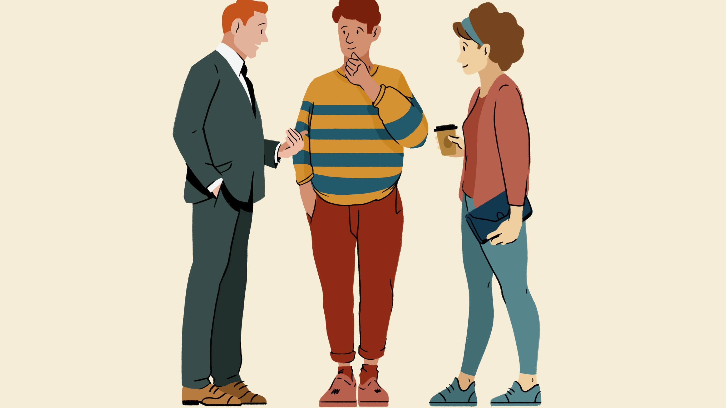
Are you a person that would need an ally in the workplace?
Notes:
Now that we have established what those acronyms mean and what it means to be an ally. We have a question for the audience. And it's totally anonymous so we are not trying to pinpoint anyone. It's more out of curiosity when we now have established the facts- if anyone here feel like you fit the description of needing an ally in the workplace.
It's not any shame needing some support in the workplace. But reaching out for it might be a tough obstacle to overcome.
Therefore we try to encourage and motivate our allies to step forward in the workplace so that the person in need doesn't feel like they have to ask for help.
There are probably more people around us than we think that would benefit from an ally.
And even if there is not a specific person for you to support, making that environment better for everyone will be beneficial.
Even more important, if your company truly doesn't house any people of minority, you need to start making those changes now so that you may attract new people. They might be scared away at the moment when they realize that this workplace has not made any changes to adept to the world we currently live in.
There have been scientific studies, which we can provide sources to, that prove that a homogenous group of people is not the best performant. You actually get more value out of a company when the people you employ have different experiences, viewpoints and challenges.

Slide 8
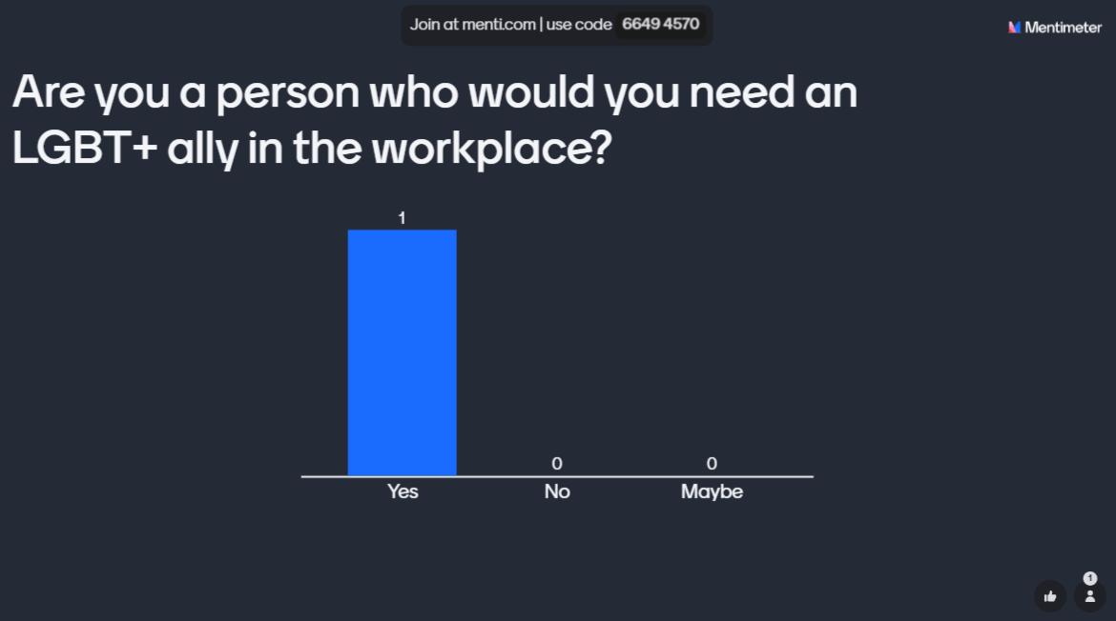

Slide 9
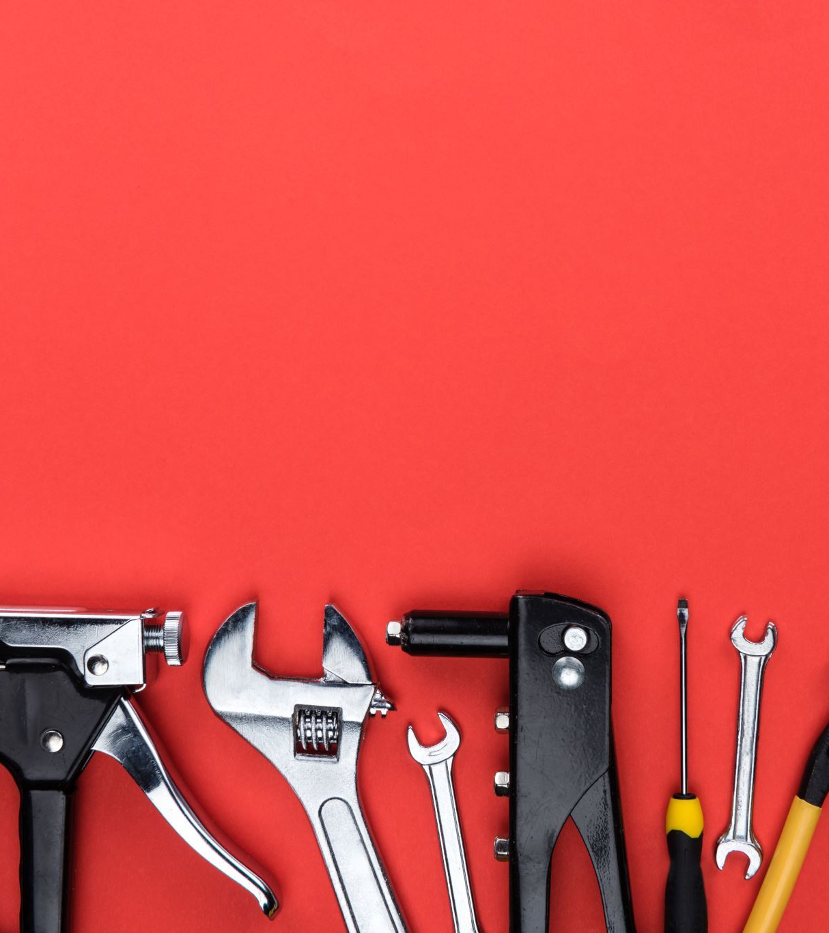
Tools to enhance your allyship with
Pronouns
Own your privilege
Accept feedback
Speak up
Sponsor marginalized people
Whose perspective are we missing?
Notes:
Pronouns - You know your pronouns, don’t assume others know them.
All people who are not a minority, have a big advantage with their privilege. It can be very hard to see your own privilege. Since you are used to it, you have no idea how it is to live without it.
For example, one of the biggest grocery store companies in Sweden had a white male at top management. He made a gender transition a few years ago to live as a woman. After the transition, she got a question from one of her employees if this would have any effect on how she acted as a manager. Which she denied.
Then slowly during her first time as a women saw a whole other perspective. That the women in the room just wasn't consulted or heard enough. So she as a manager started to bring everyones points of view up to surface more. I'm equal parts happy about this as I am sad that it required a gendertransition for a person to realize their privilege.
But we cant know what we don't know. So the fact that you don't know what your advantages are doesn't mean that they don't exist.
Things that people struggle every day with are just normal for other people.
This brings us to the next thing of accepting feedback. For anyone to grow and do better, we need feedback. Therefore don't take it as a personal offence if someone where to ask you to not assume pronouns or things like it. Make it a learning opportunity for you.
Speaking up- that is the one easy way for any ally to make a statement. When someone is misprononuced, maybe you can help correct that. If the person feels comfortable with that of course. Or just speak up in a meeting where not everyones voice is beeing heard.

Slide 10
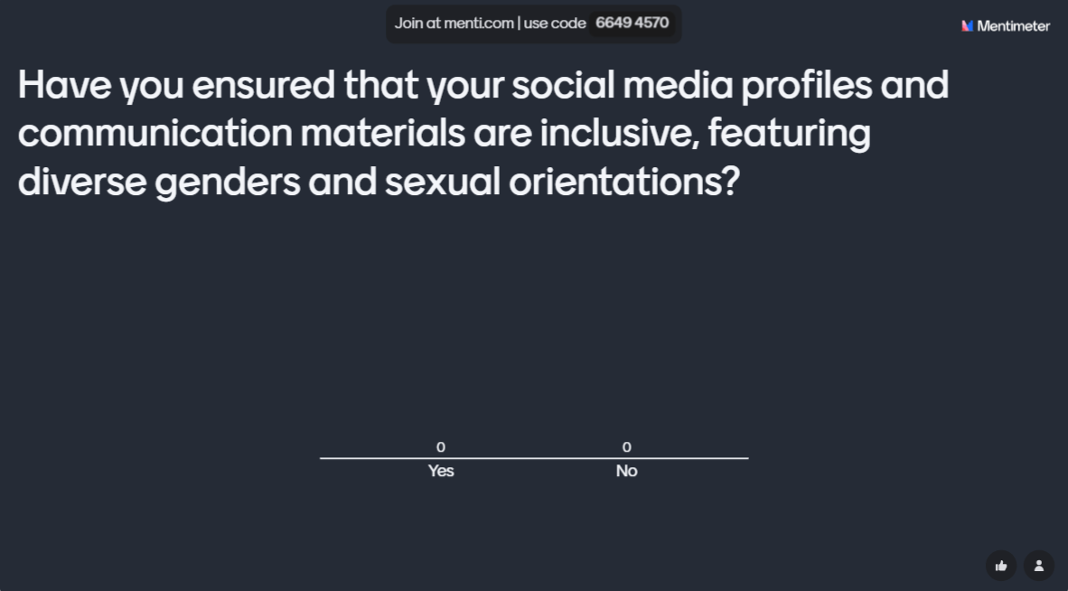
Notes:
It doesn’t stop with saying you are pro diversity. What do you really do about it?

Slide 11

We’re all somewhere on the staircase to being a good ally
Notes:
We are all on this staircase somewhere, we feel like we have stuff to share, but we are also on this staircase of learning still too
Also everybody makes mistakes

Slide 12
Scenarios
Take a step based on where you stand
Notes:
Wherever you are – the goal is to add some tools to your toolbelt so you can take one more step up the staircase

Slide 13

Microaggressions
a term used for commonplace verbal, behavioral or environmental slights, whether intentional or unintentional, that communicate hostile, derogatory, or negative attitudes toward stigmatized or culturally marginalized groups

Slide 14
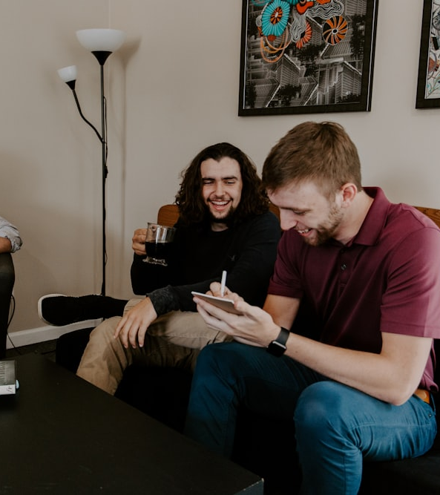
Use Inclusive language
'Hi guys’
Sexual preference
Chairman, Doorman, Fireman
Blacklisted Vs Whitelisted
Crazy, Nuts, Insane
Notes:
Using inclusive language just means we are trying not to discriminate against any groups and to include all people in our conversations and discussions
Greeting people with gender, hi guys, ladies and gents – we could instead use ‘everyone’ or I personally use ‘folks’ , hi folks, thanks folks. Some American friends use y’all – but that sounds weird in my hybrid US\UK accent.
Asking about sexual preference – it is not a choice
It’s a man’s world – job titles that use man in them
Blacklisted is being rejected, whitelisted means you’re approved – or black hat\white hat
Mental health – using these words to describe a situation, but could be offending someone with a mental illness – also we quite often say ‘sanity check’ which isn’t very inclusive.

Slide 15
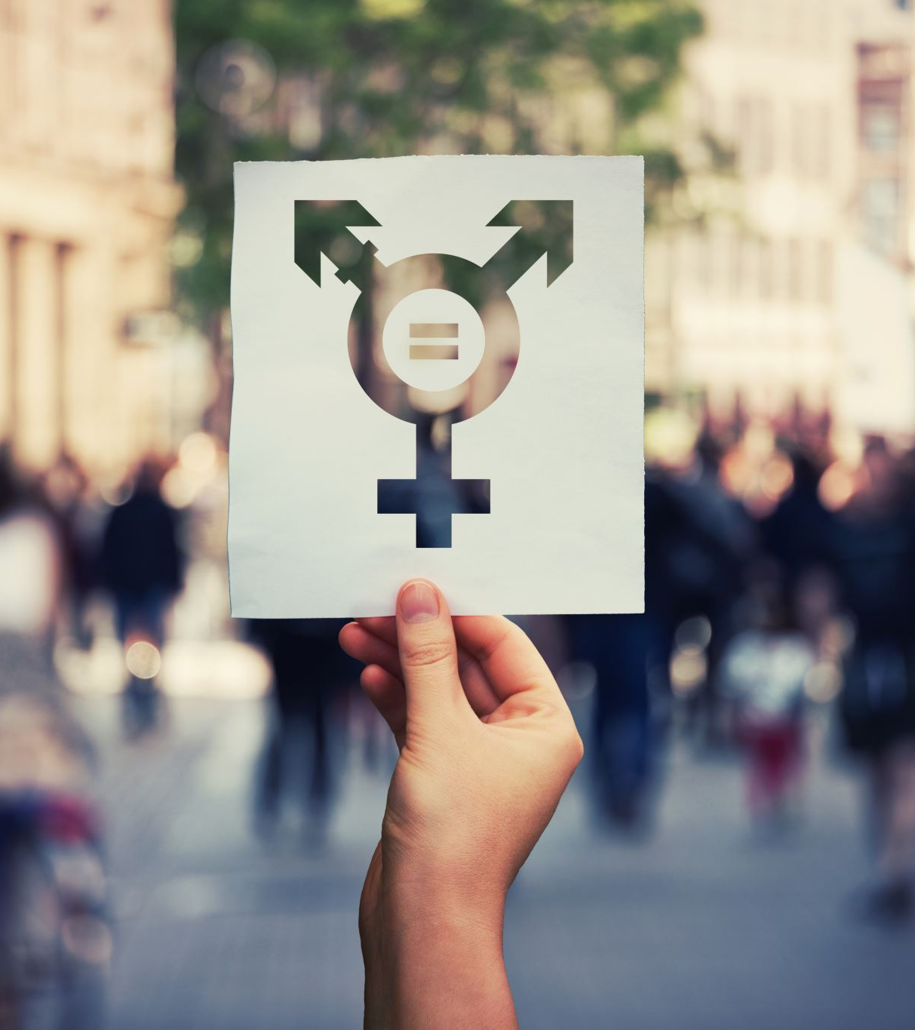
How long have you been with your husband?
Assuming hetrosexism
Heterosexual relations are the ‘norm’
Everyone is ‘cis-gendered’
Notes:
Linda tells story about teacher

Slide 16
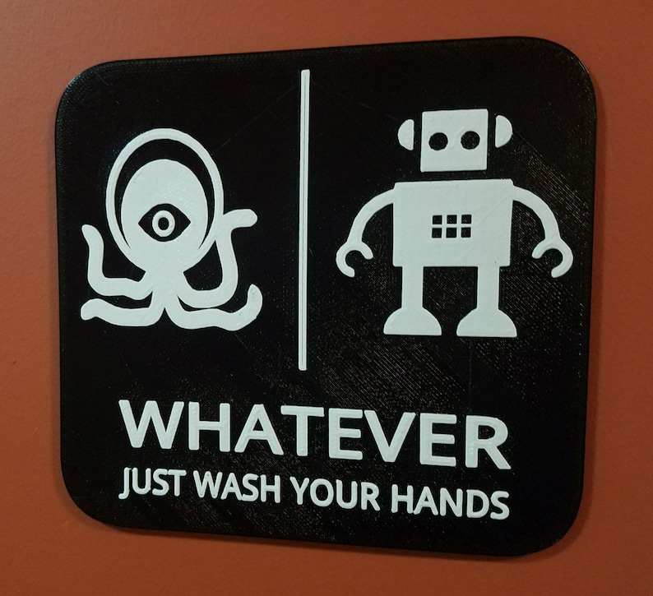
Is this the women’s bathroom?
Notes:
Jess tells story about getting thrown out of bathrooms

Slide 17
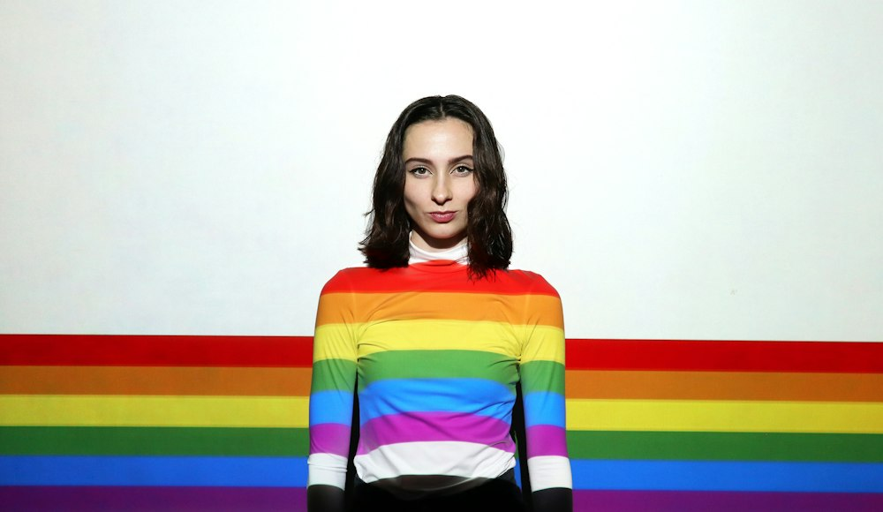
Oh, you don’t look gay?
Notes:
Jess tells story of kelc gets this all the time
Stereotypes of short hair

Slide 18
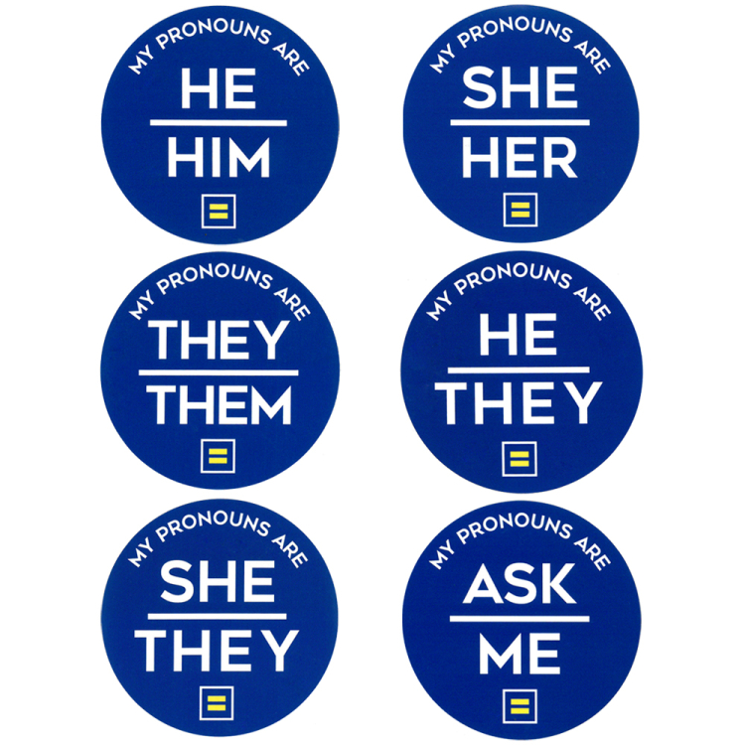
Meeting new people
Introduce with pronouns
Notes:
Intro with pronouns
When you’re standing chatting at a conference, make a U shape so new people can join in, rather than an O that is closed off

Slide 19
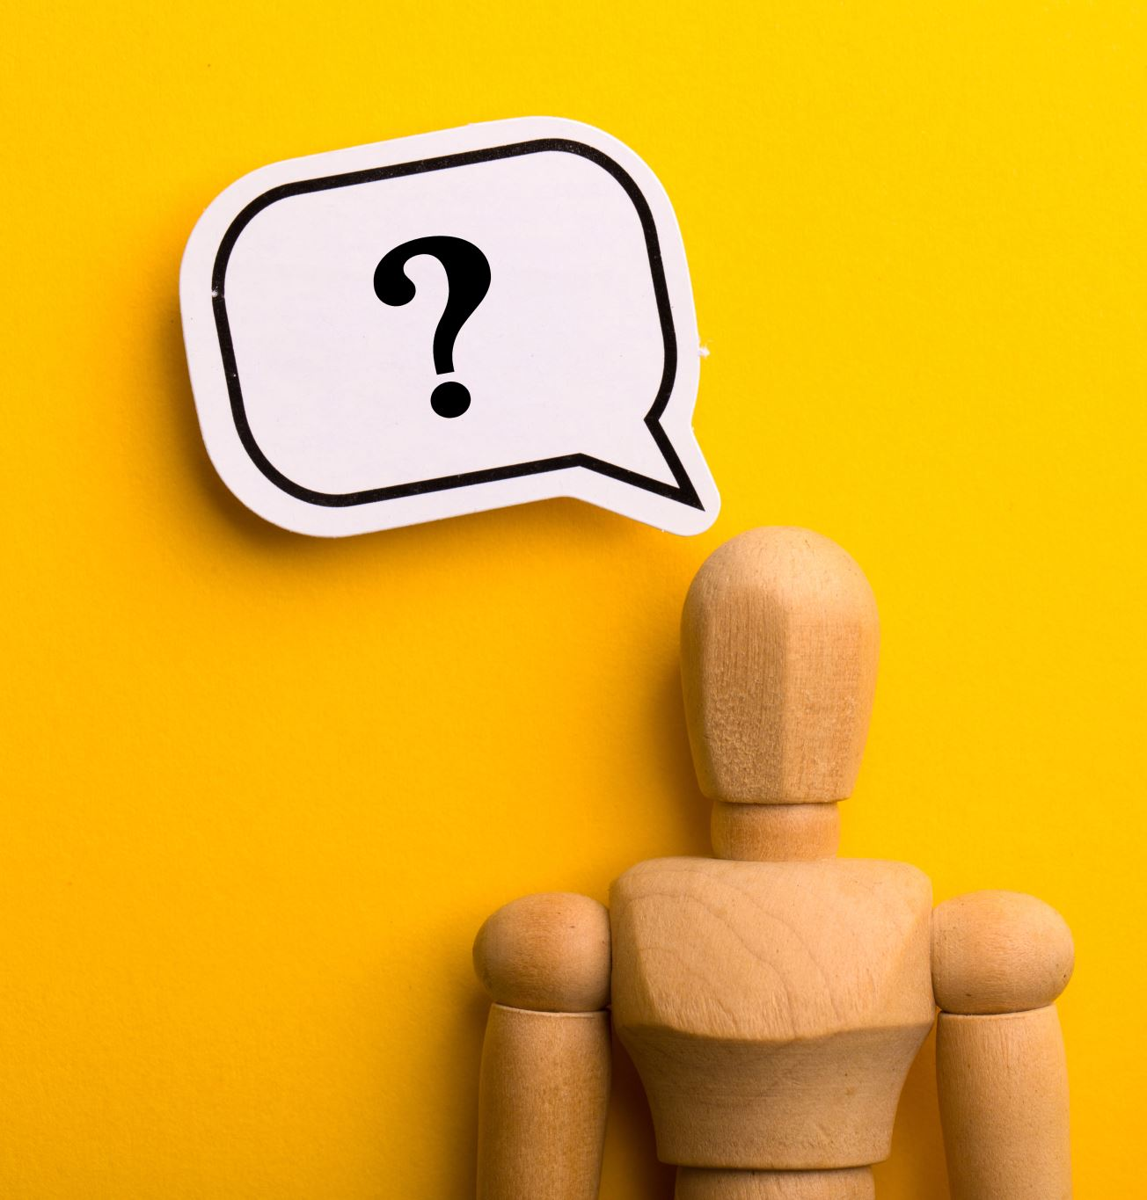
Speak up
If you see/hear something – say something

Slide 20
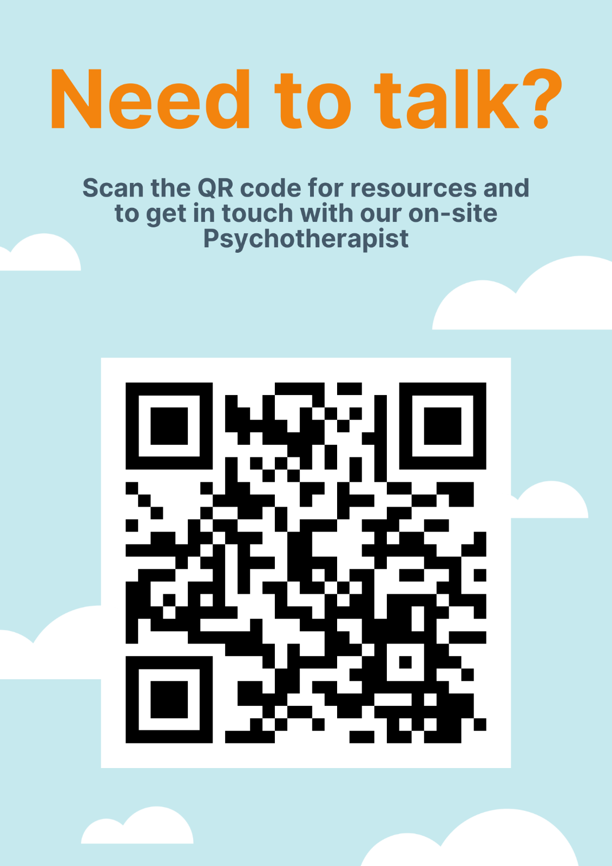
Look after yourself
sqlbits.io/needtotalk
Notes:
sqlbits.io/needtotalk

Slide 21

Support
Make yourself a safe space for talk/allyship or any kind of support

Slide 22
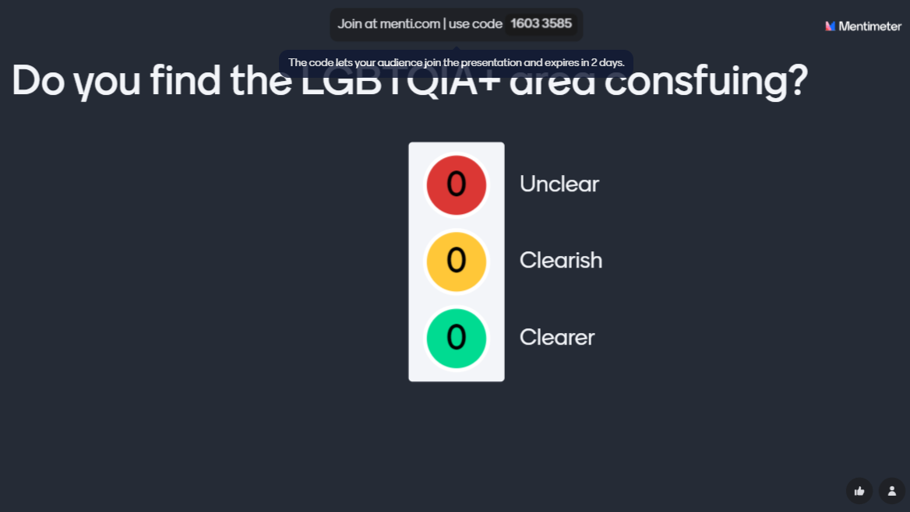

Slide 23
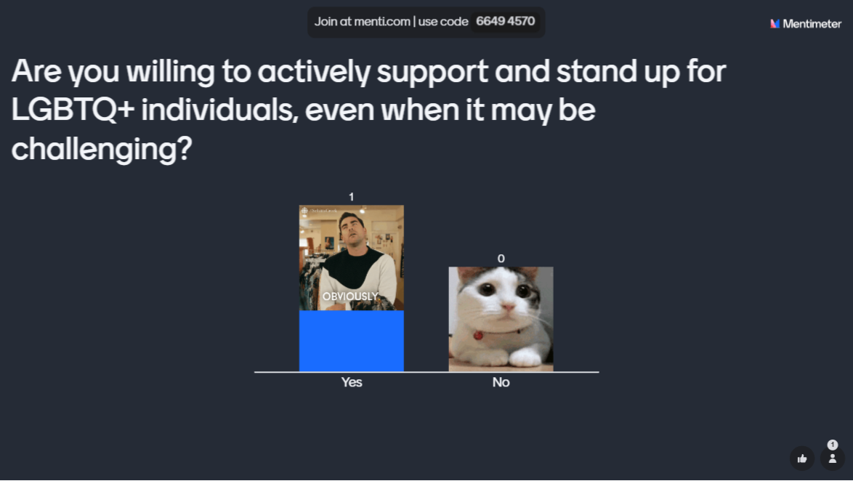
Are you willing to actively support and stand up for LGBTQA+ individuals, even when it may be challenging?

Slide 24

The power of allyship

